Slide 1
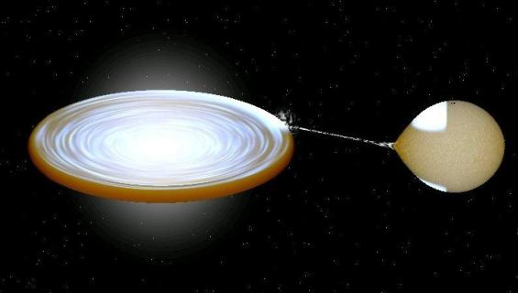
Accretion power in astrophysics
Alexandra Veledina (U Turku/Nordita)
Tuorla, 13 October 2017

Slide 2
Source of Sun energy
2 erg/s/g (rotting leaves)
Problem: very long life time (40-s of XIX)
Accretion of meteorites (R. Meyer)
Slow contraction, ~10⁷ y (H. Helmholtz, Lord Kelvin)
Thermonuclear reactions (A. Eddington)
Notes:
Human body: 4 orders higher power -> eat 3 times; Sun does not eat for billiards of years

Slide 3
1962,1964
the first neutron star and black hole
were discovered
Bright X-ray emission
Rapid X-ray variability

Slide 4
~10% of rest mass energy is converted to radiation
Compare this to efficiency of thermonuclear reactions that power Sun
Analogous to hydroelectric power derived when water falls over a dam

Slide 5
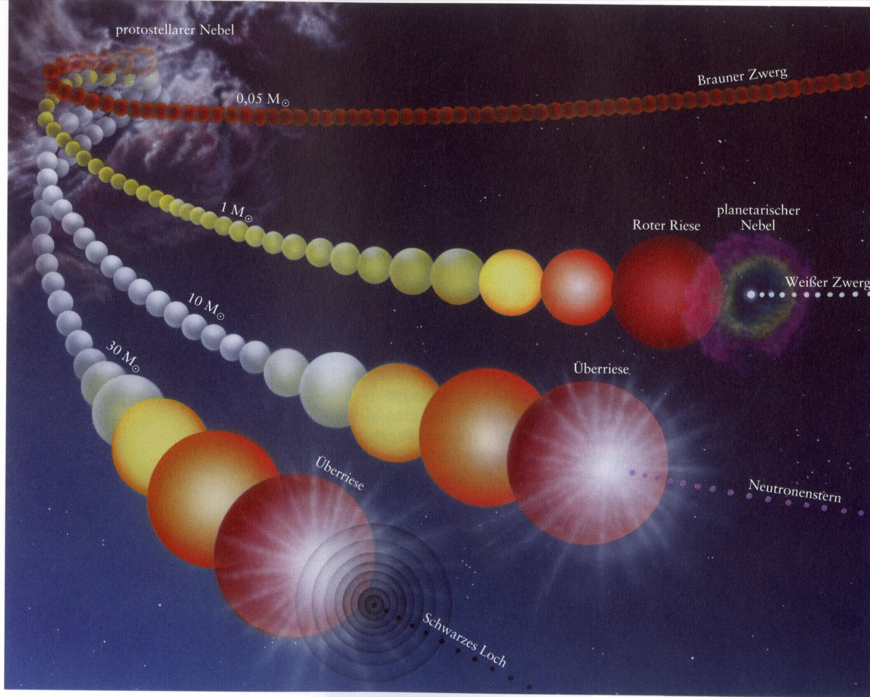
Fate of massive stars
WD: M ~ 0.5 – 1 M_{Sun}
R ~10 000 km
NS: M ~ 1.4 – 2.2 M_{Sun}
R ~ 10 km
BH: M ~ 7 M_{Sun}
R_{S} = 3 (M/M_{Sun}) km

Slide 6
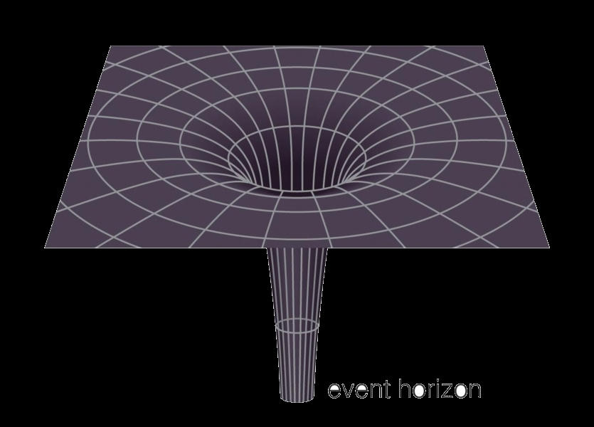
R_{Sch} = 2GM/c²
Event horizon
Earth: R ~1 cm
Sun: R~ 3 km
Singularity

Slide 7
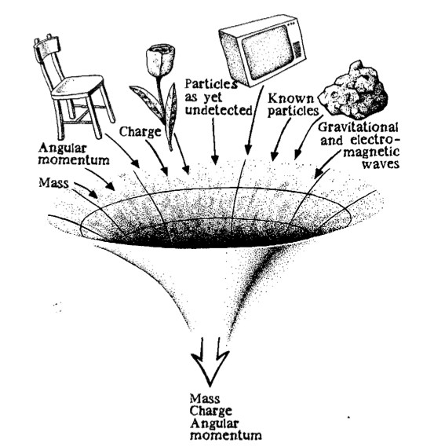
No-hair theorem
J. A. Wheeler
Black Hole

Slide 9
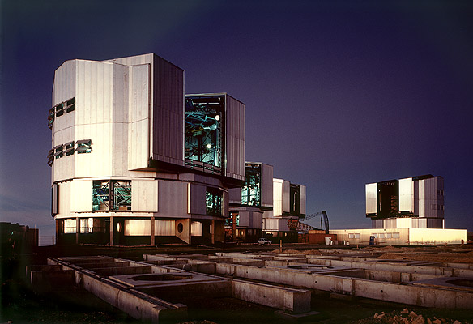
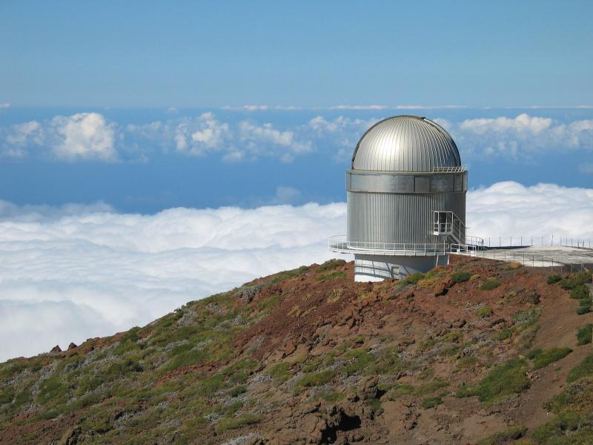
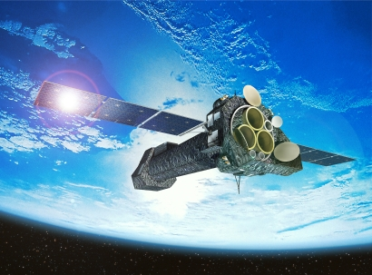
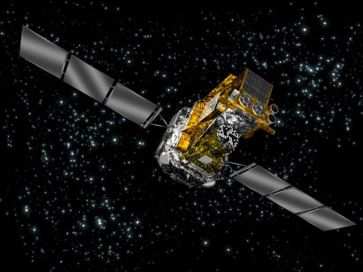
NOT, Nordic Optical Telescope
La Palma, Canarian Islands
VLT, Very Large Telescope
European Southern Observatory, Chile
X-ray observatory XMM-Newton
Optical
UV
X-ray
gamma-ray
telescopes
Hubble Space Telescope
INTEGRAL, International Gamma-Ray
Astrophysical Laboratory

Slide 10
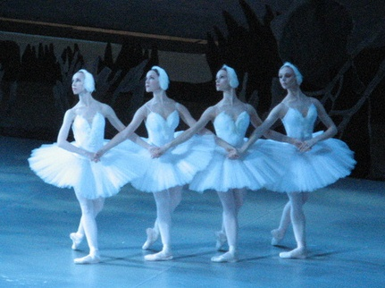
We see

Slide 11
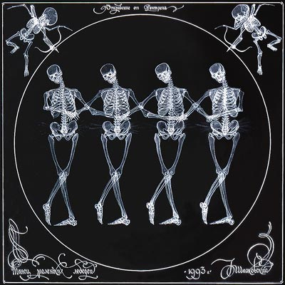
X-ray vision

Slide 12
X-ray vision
But optical vision is also important…

Slide 14
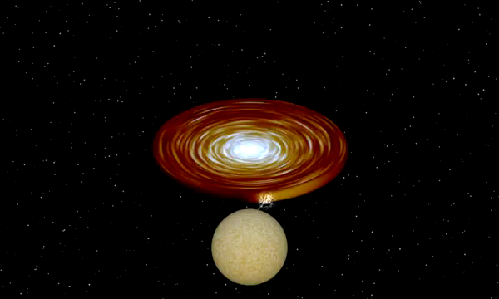
Credit: BinSim by R. Hynes

Slide 15
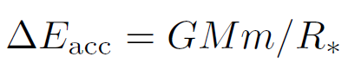
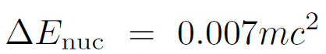
Accretion as a source of energy
For NS: ~10²⁰ erg/g
For WD: E_{nuc}/E_{acc} ~ 25-30
But: different timescales (steady accretion vs. run away nuclear)

Slide 16
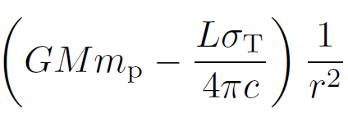
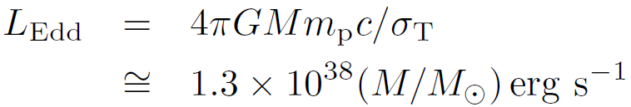
The Eddington limit
Accreting H⁺, electron Thomson scattering, steady spherically symmetric accretion flow
f L_{Edd} if the accretion occurs only over fraction f
But: supernovae, complete ionization
Standard candles: L~L_{Edd}
Notes:
For bricks: m=4000g; S = 100 cm2. m/S = 40; m_p/sigma_T = 2.5

Slide 17
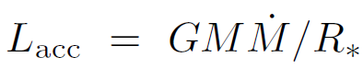
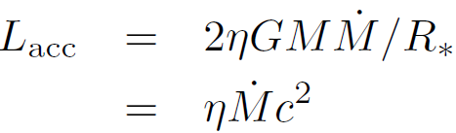
The Eddington limit
All the kinetic energy is given to radiation at stellar surface
In the case of a BH (no solid surface)
Efficiency is approx. the same for BH and NS
AGN: 10⁴⁷ erg/s, efficiency~0.1 => 10⁹ M_{Sun}

Slide 18
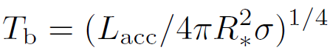
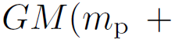
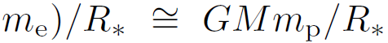
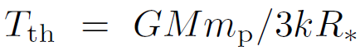
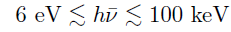
The emitted spectrum
Lower boundary: blackbody radiation
Upper boundary: gravitation potential energy is turned entirely to thermal energy
Opt.thick: Opt.thin:
NS,BH:
WD:

Slide 19
P: 3h – 33d
~25 confirmed BHs
M_{BH}: 3M_{Sun} – 15M_{Sun}
By J. Orosz
(http://mintaka.sdsu.edu/faculty/orosz/web/)

Slide 20
X-ray spectra

Slide 21
X-ray spectra and geometry
Hot thermal
plasma kT_{e} ~ 30-200 keV τ ~ 1
Hard Comptonized photons
Soft seed photons
Amplifier
Comptonization
Multiple inverse Compton scattering: energy transfer from electrons to photons.
log EF_{E}
log E
100 keV

Slide 22
Outburst, q-diagram
Munoz-Darias et al. 2013
Sobolewska et al. 2011
What is the geometry in the hard state?

Slide 23
Proposed geometries
Sandwich corona
(Haardt & Maraschi 1991, 1993; Stern et al. 1995; Poutanen & Svensson 1996; Zdziarski et al. 1998; Malzac et al. 2001)
Too soft spectra Γ>2
Hot flow models
(Eardley & Lightman 1975; Ichimaru 1976; Narayan & Yi 1994, 1995; Poutanen et al. 1997; Esin et al. 1997; Yuan et al. 2007; AV et al. 2013)
Seed photons?

Slide 24
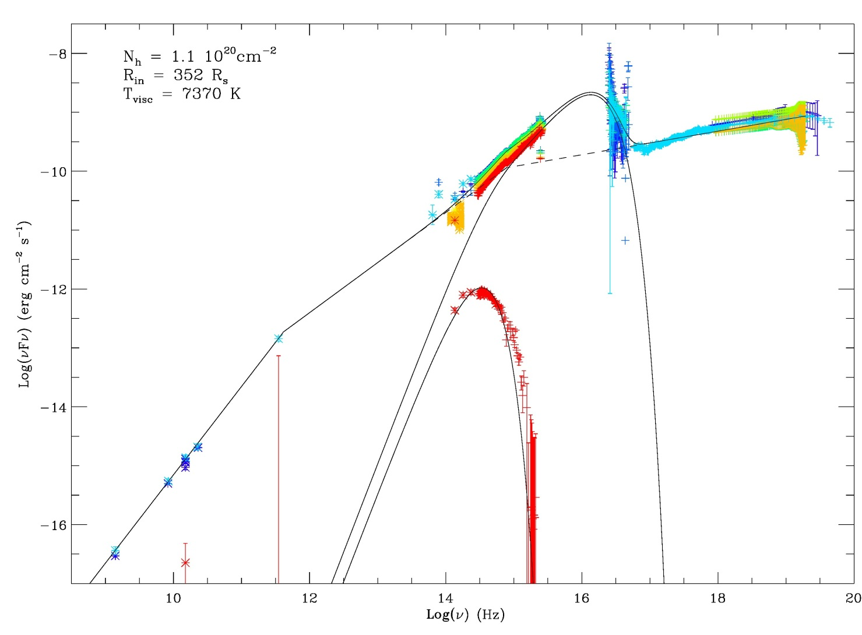
Broadband spectra of LMXBs
X-rays: Corona
Hot inner flow
Jet? Accretion disc?
Inner hot flow?
Radio: Jet
XTE J1118+480
Chaty et al. 2003

